Slide 1

INT331-Data maNAGEMENT
Solar and lunar eclipse
By
Sunnam sai Jyothi Swaroop
Reg:-11802400
Under the Guidance of
Komal Arora-17783

Slide 2

Introduction to project
Dataset is of Solar and lunar Eclipse from Kaggle which contains 2 workbooks of dataset separately and got from Kaggle.com
Each consists of 20 columns and 12000 rows of data.
There are many steps for our final out of the data.
The aim of the project is modify the data and visualize the data.
Excel is a computer program used to create electronic spreadsheets, Within excel user can organize data ,create chart and perform calculations, Excel is a convenient program because it allow user to create large spreadsheets, reference information, and it allows for better storage of information, Excels operates like other Microsoft(MS) office programs and has many of the same functions and shortcuts of other MS programs.

Slide 3

Steps to get results
Cleaning the data
Removing Special Characters
Removing null values
Split the values
Replacing the null values
Making Pivot Table
Making the pridections
Sum the values
Avg the values
Max and min the values

Slide 4

Steps to get results
Making Pivot Charts
From pivot table
Selecting the type of chat suitable
Modifying the chart
Making attractive
Extract Data
Select the data from Data Tab and extract the data
Transform The data
Transform and modify the data
Filter null values and replace the calculations
And save the values
Manage the values and make an overview connections

Slide 5

Steps to get results
Load the data
Loading the data model
Making connections and joins
Slicers
Making slicers gives an option to see the analysis
DashBoard
Bring Data into Excel
Set Up Your Excel Dashboard File
Create a Table with Raw Data
Analyze the Data
Build the Dashboard
Customize with Macros, Color, and More

Slide 6
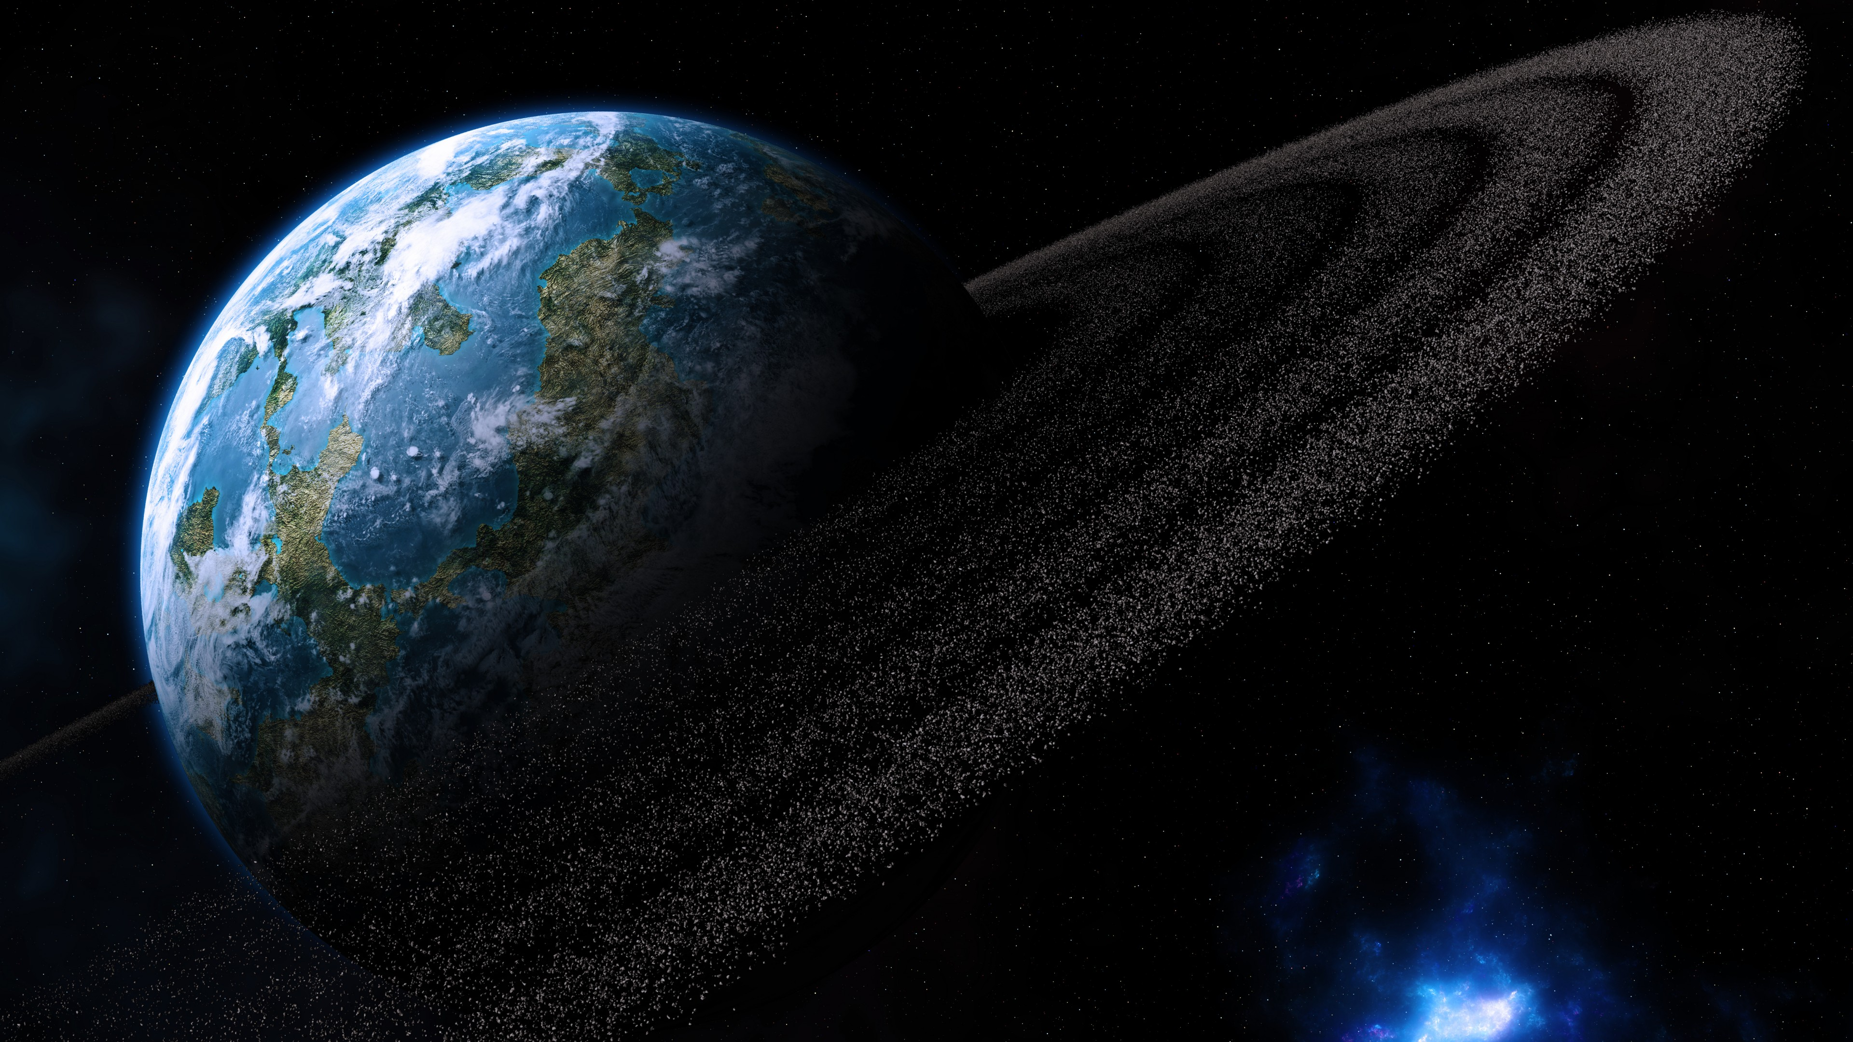
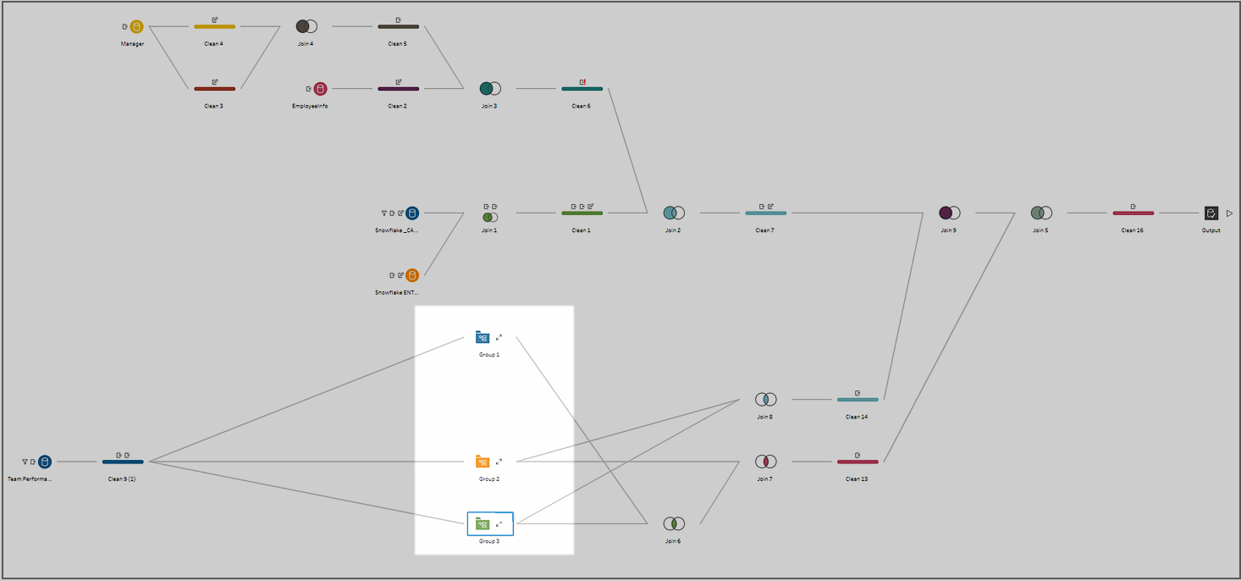
Steps to Result
Tablueau
Clean Step
Aggregate
Pivot
Join
Union
Script
Output
Paste Steps
Insert Flow

Slide 7
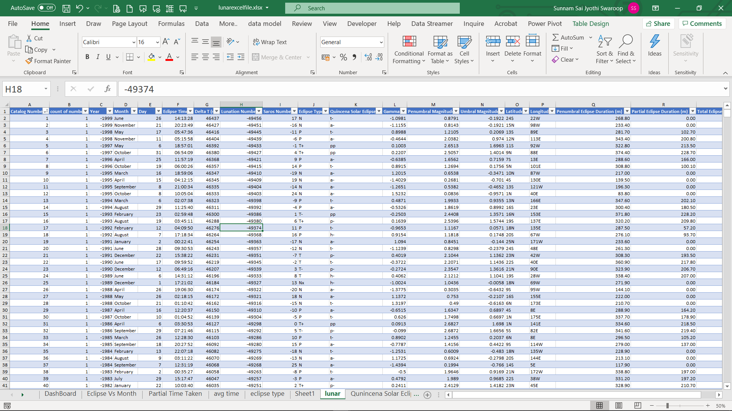
Cleaning the data

Slide 8
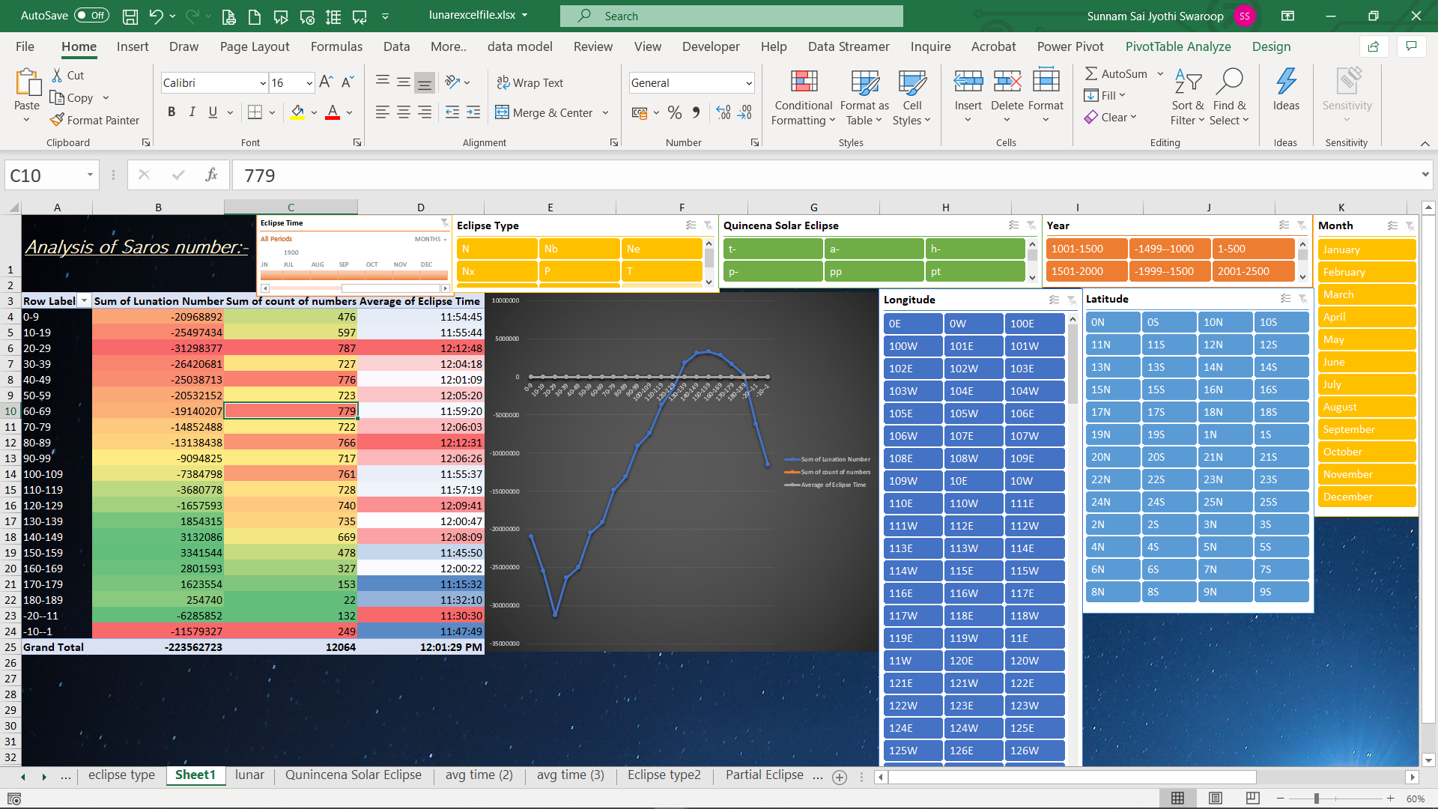
Making pivot table

Slide 9
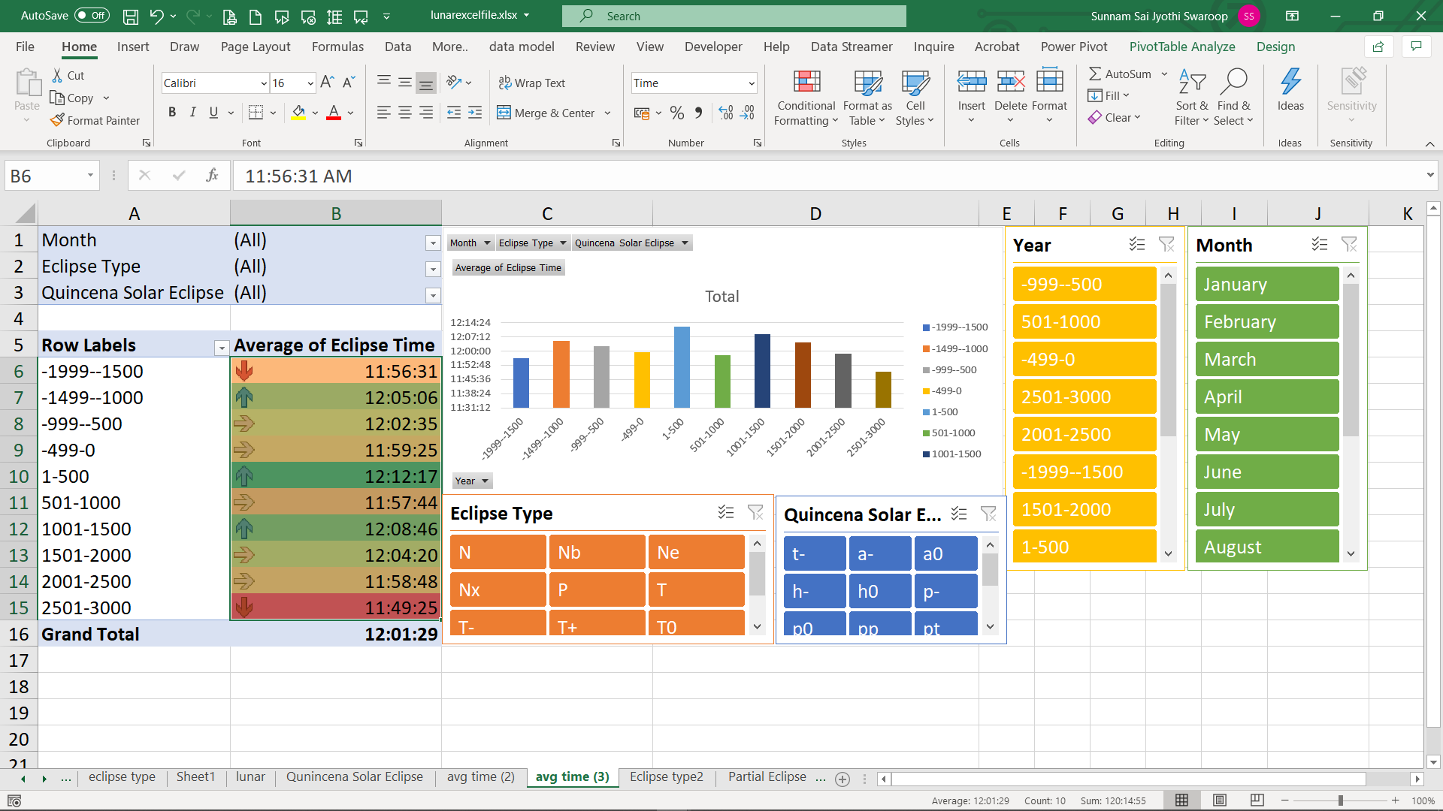
Making Pivot charts

Slide 10
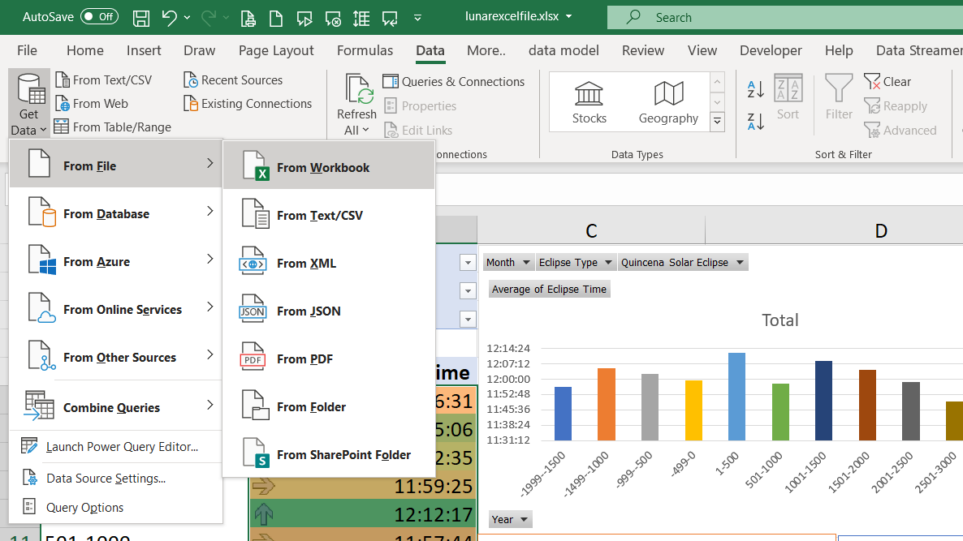
Extract Data

Slide 11
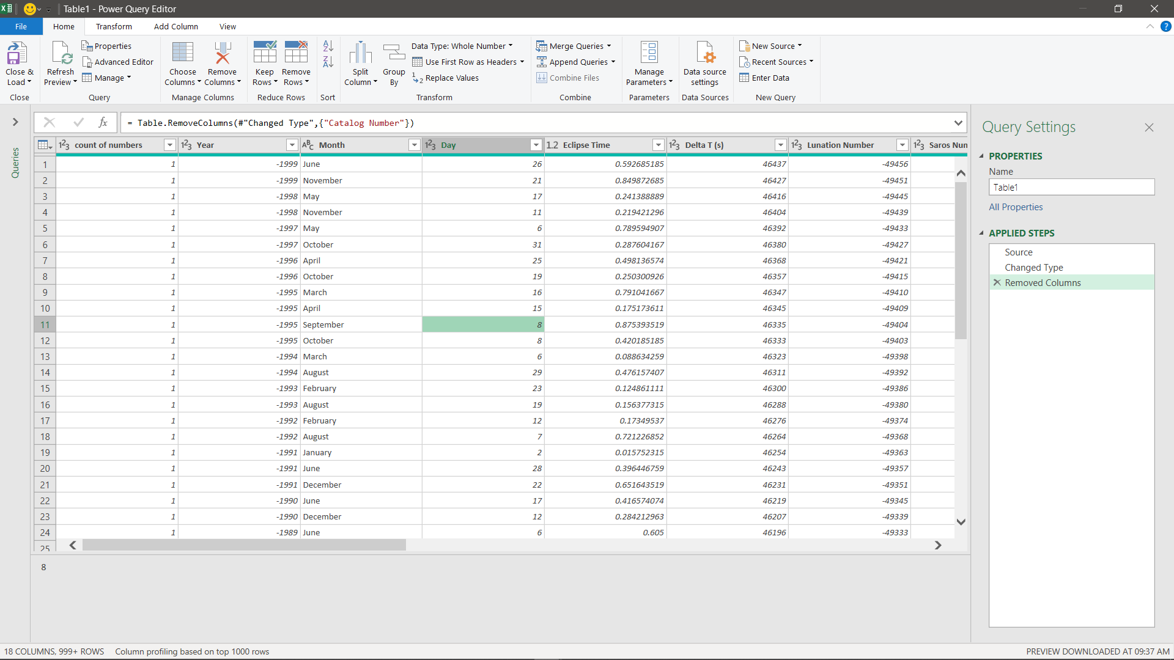
Transform Data

Slide 12
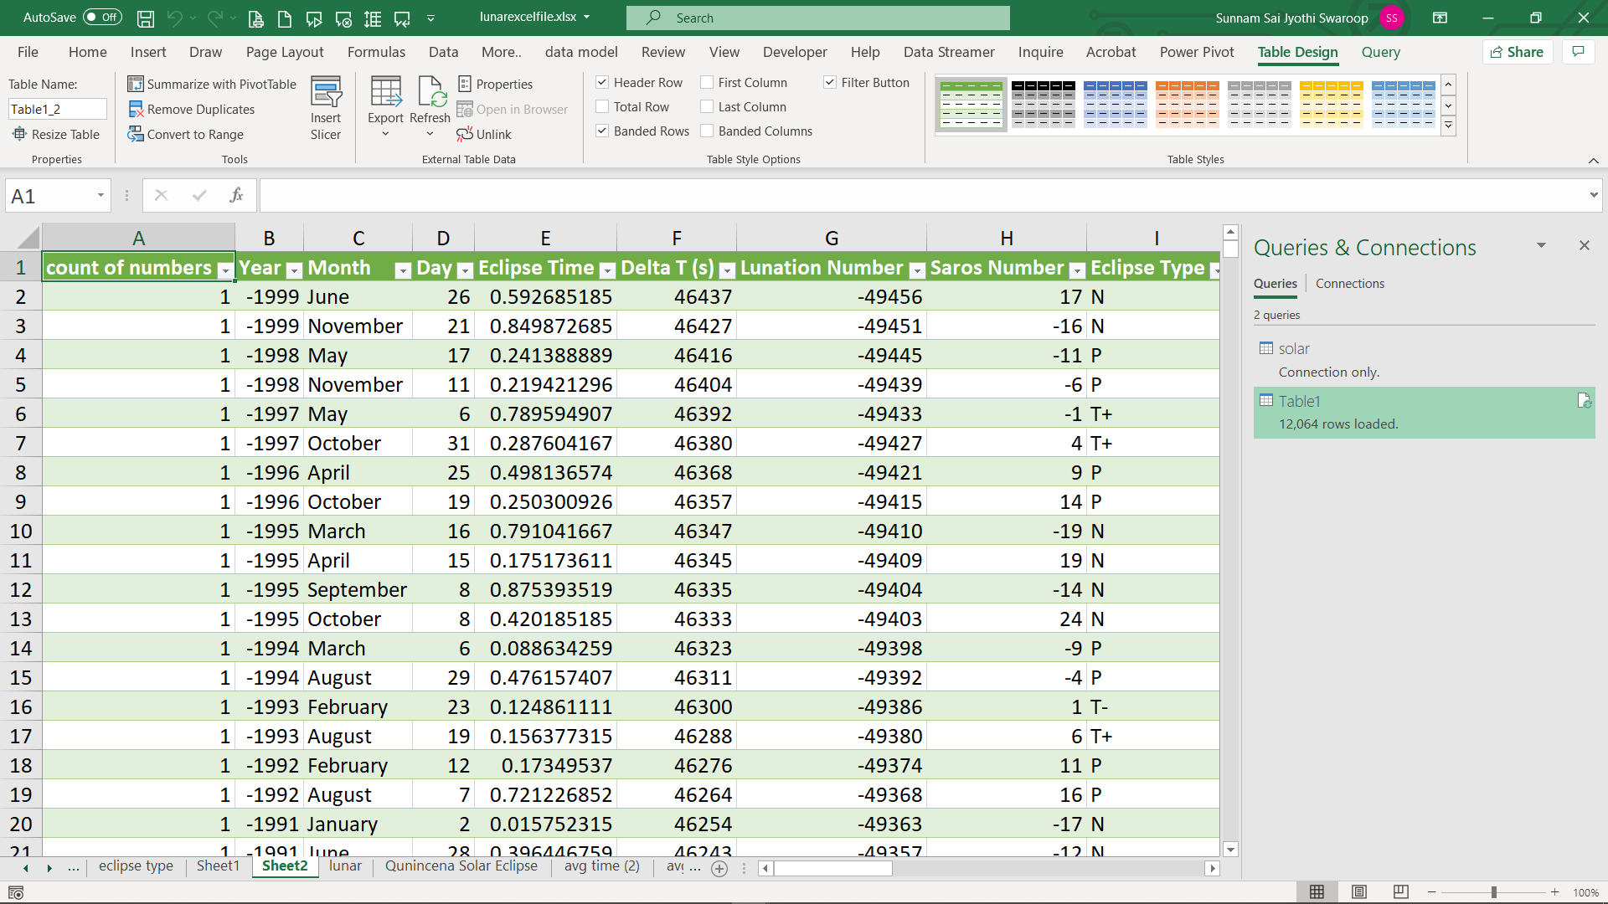
Load Data

Slide 13
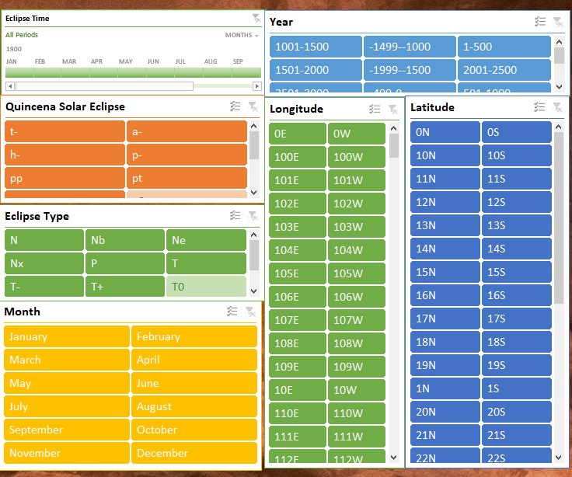
Slicers

Slide 14
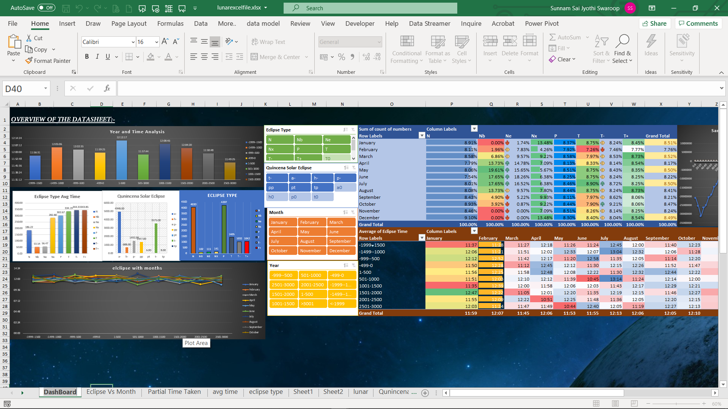
DashBoard

Slide 15
Tableaue

Slide 16
Thank you

